Slide 1
Theory vs. Implementation: Altered Functional Connectivity of the Blind Primary Visual Cortex
Jessica Huang
Harvard Class of 2020
Ella Striem-Amit, Postdoctoral Fellow, Harvard Department of Psychology
Notes:
Hi, I’m Jess and this summer I worked on the 9th floor of William James Hall with a postdoctoral fellow, Ella Striem-Amit. Together, we built what I’ll show you today. And it’s my hope that by the end of this presentation, you get a sense of our project and even more generally, some hidden ingenuity already embedded in common techniques of neuroimaging.

Slide 2
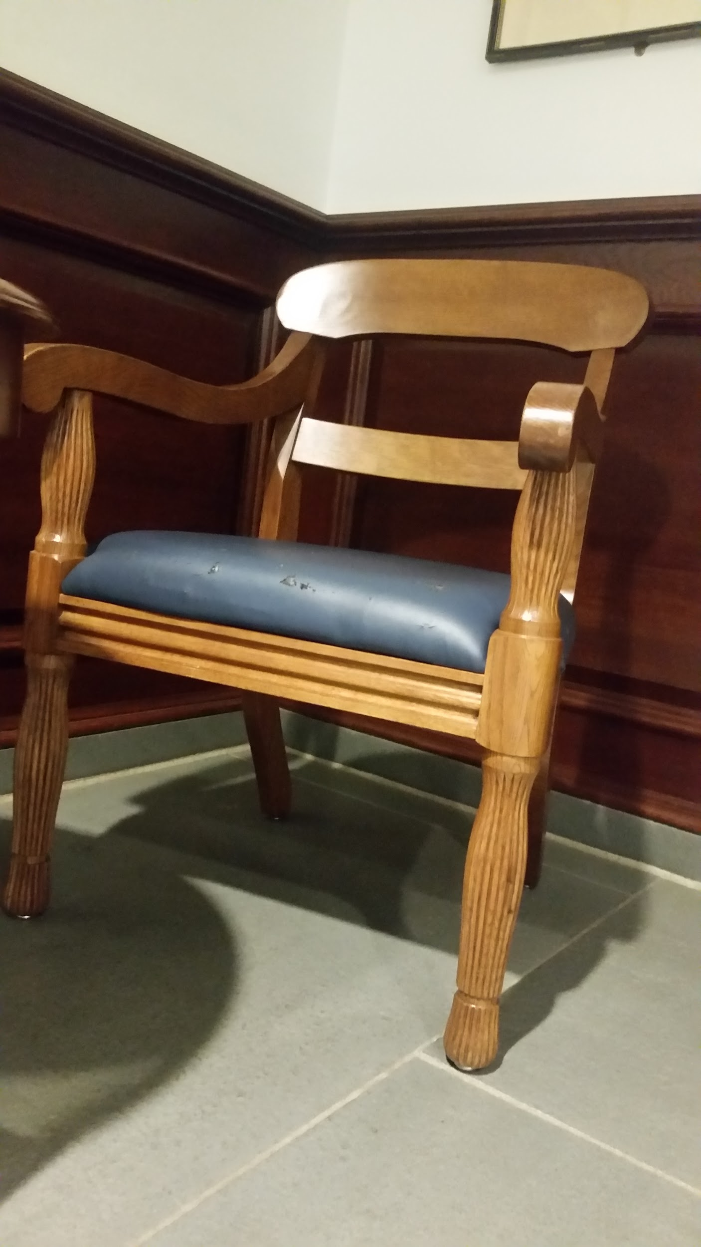
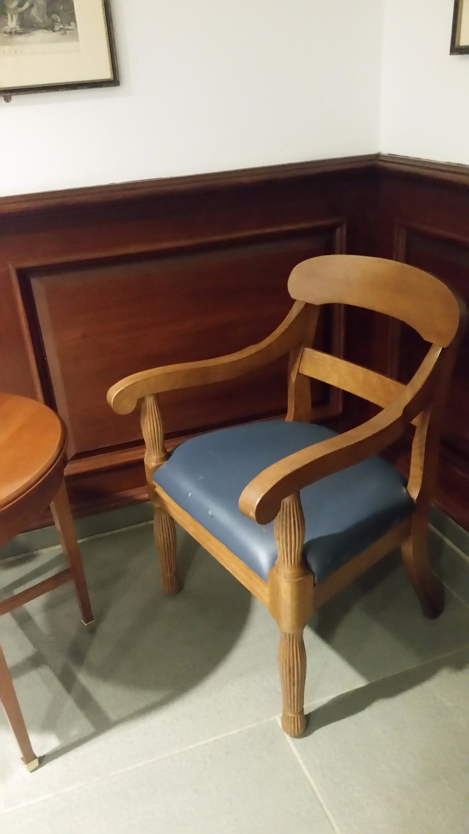
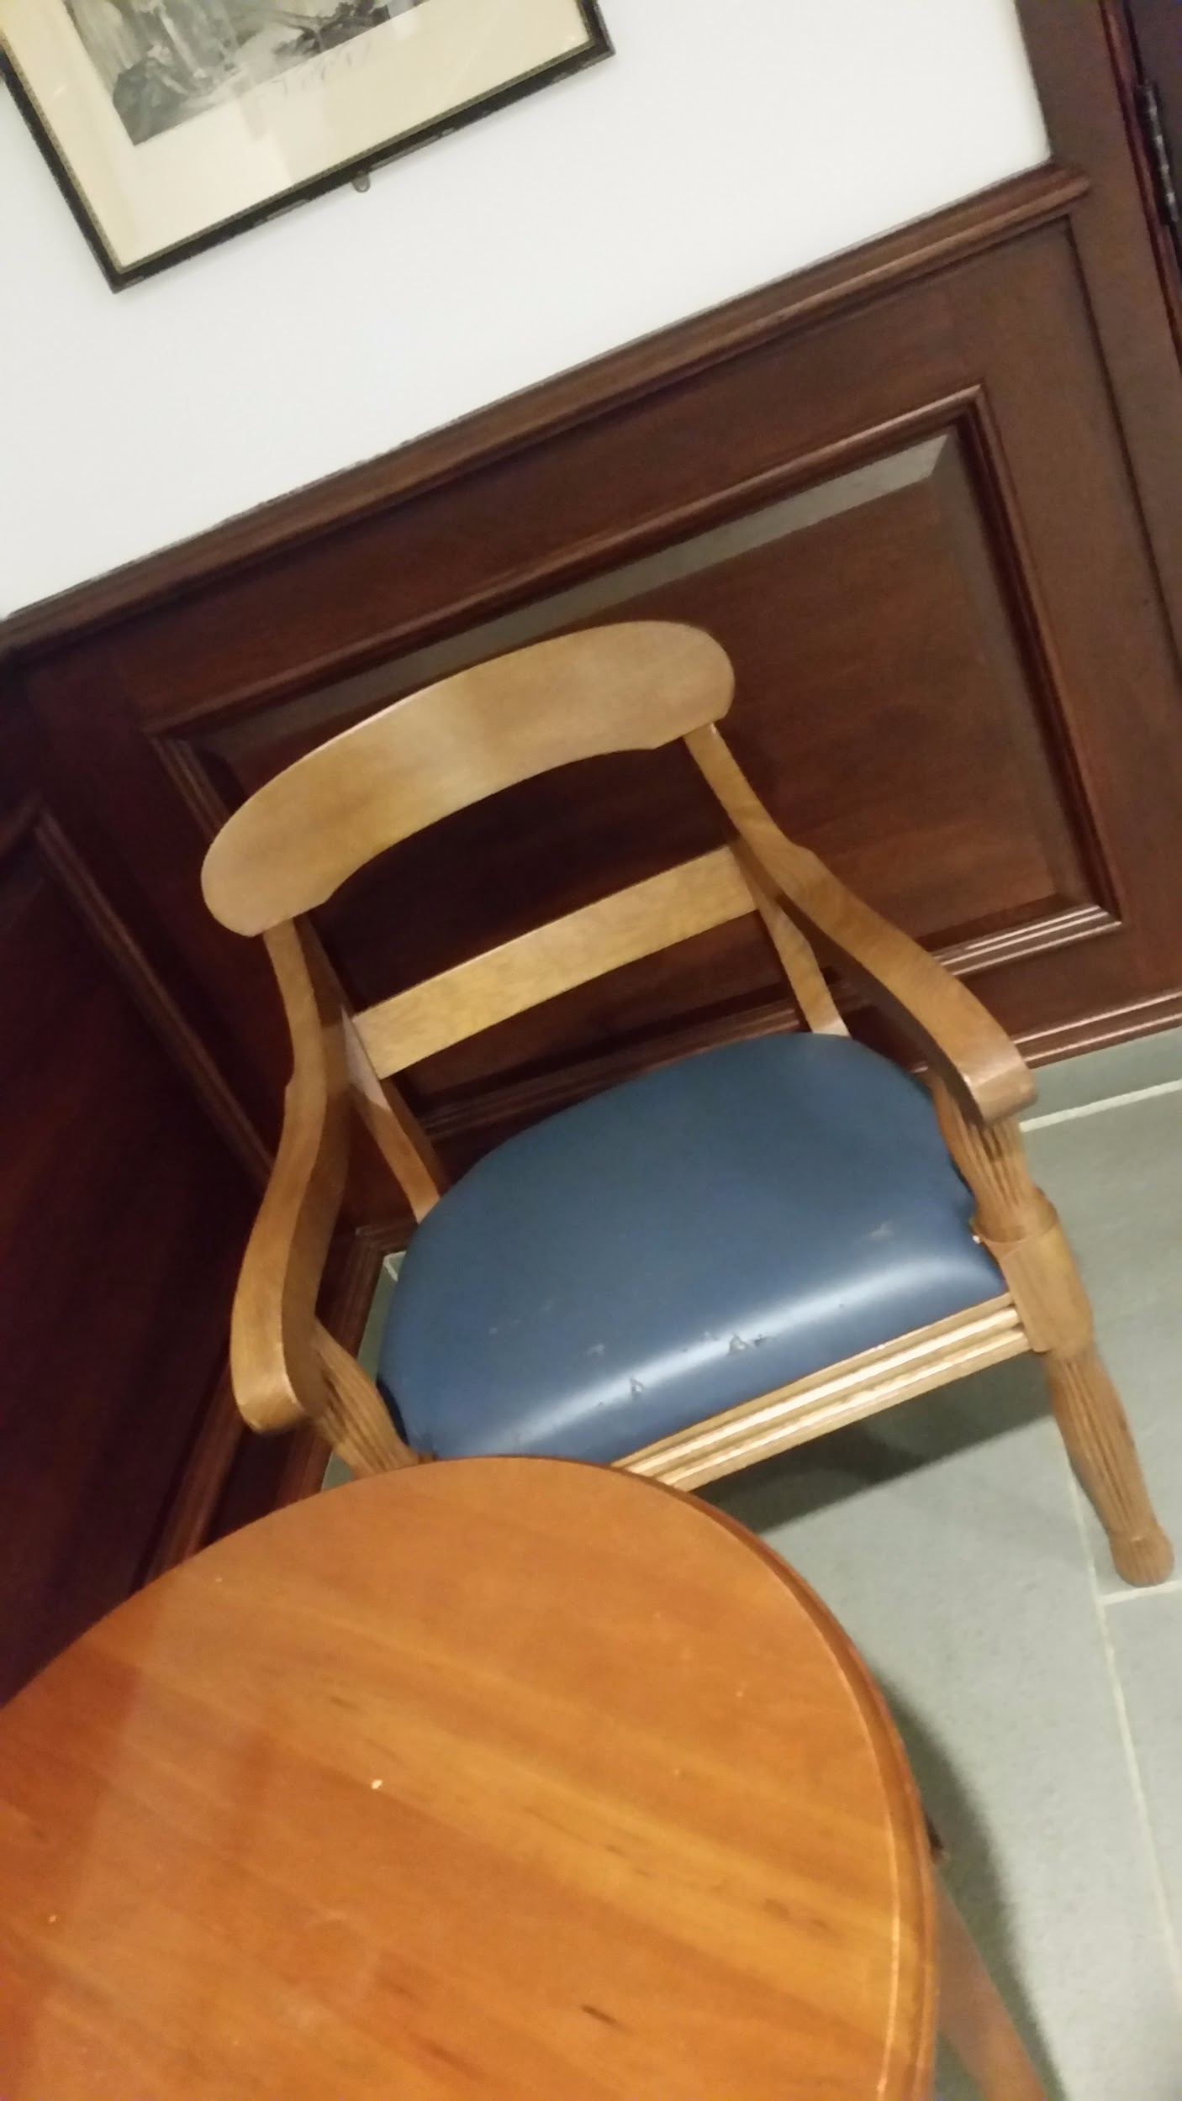
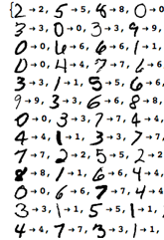

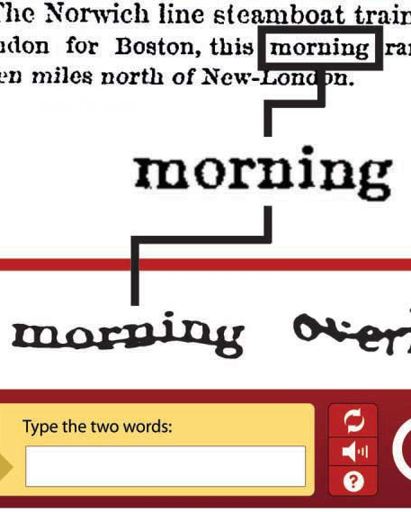
The Power of Vision
Human vision enables understanding the physical world via depth perception, pattern recognition, perspective, image reorientation
Different Views of the Same Chair
Semi-Automated
Computational Image Recognition
Notes:
Let’s start with some day to day context.

Slide 3
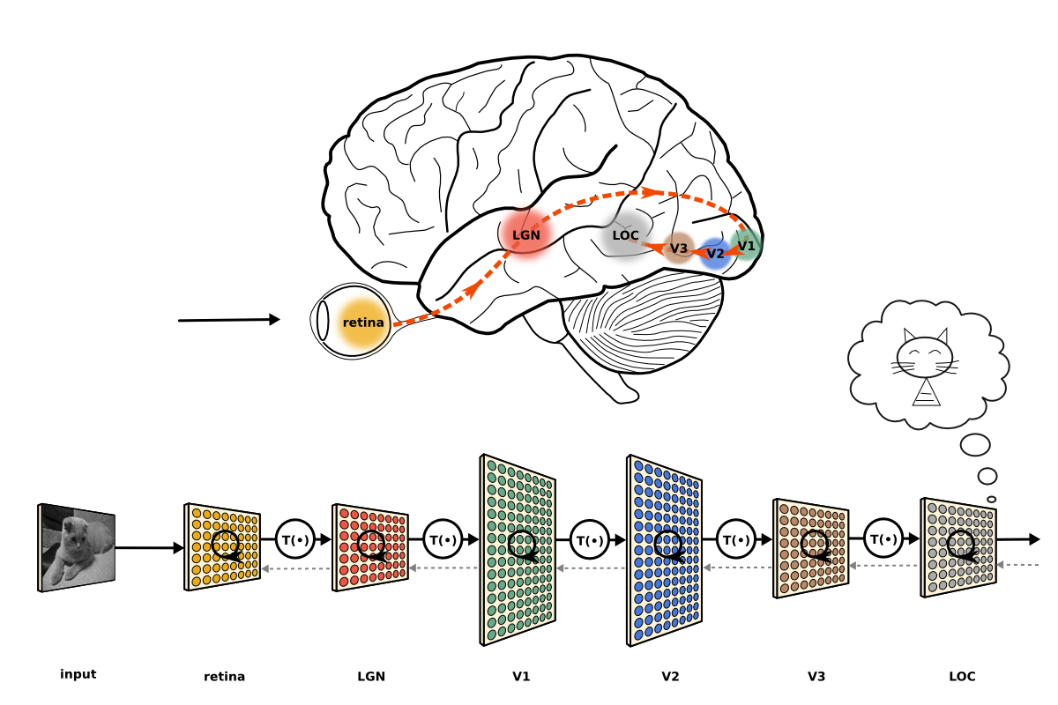
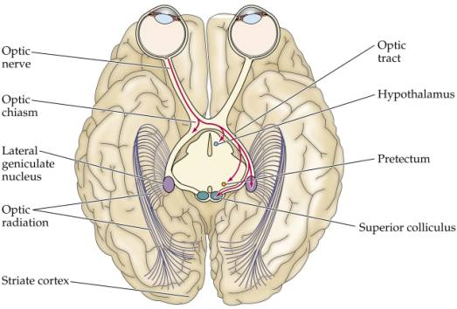
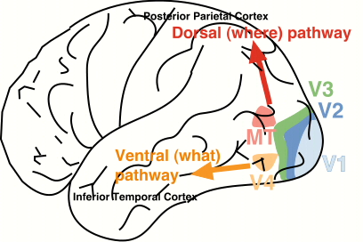
A Fascination with Visual Networks
The brain’s image processing inspires computational neural networks
Vision is hardwired into the brain:
The Ventral Stream &
Computational Neural Networks
Wiring of the Visual Hierarchy
The Dorsal and Ventral Streams
Notes:
http://imedicalcenter.blogspot.co.id/
Cipollini, 2015: https://neuwritesd.org/2015/10/22/deep-neural-networks-help-us-read-your-mind/

Slide 4
Visual Networks in the Blind
How does the visual network develop and behave when deprived of visual stimulation?
Resting State vs. Task Based fMRI
Congenitally Blind vs. Injury Induced Blindness
Nature vs. Nurture
Notes:
Blindness is one change that challenges and deepens our understanding visual networks
Open question in the field to dig deeper

Slide 5
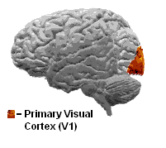
Visual Networks in the Blind
How does the visual network develop and behave when deprived of visual stimulation?
Resting State vs. Task Based fMRI
Congenitally Blind vs. Injury Induced Blindness
Nature vs. Nurture
Long Term Goal of Project:
Understand the resting state dynamics of the primary visual cortex (V1) in the congenitally blind
Notes:
We focus on one brain state, one visual hub, and one subject population

Slide 6
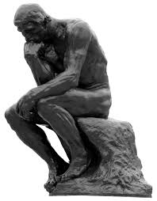
Theory: An Overview of Exploring V1

Slide 7
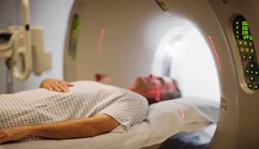
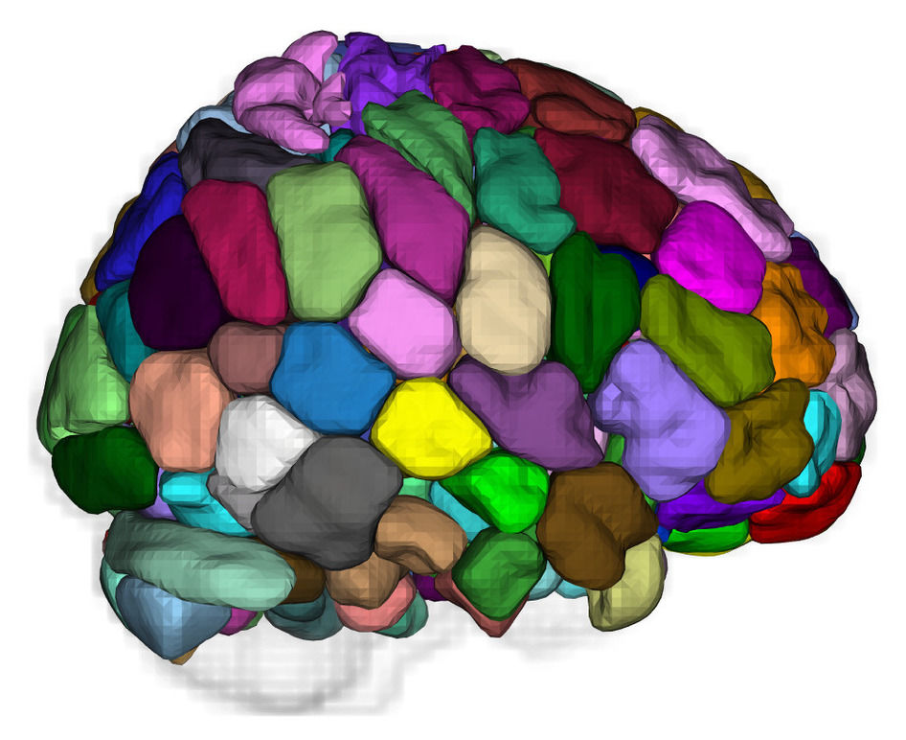
Overview of Materials and Proposed Analysis
Subjects
13 sighted controls
11 blind subjects
Neuroimaging
Structural MRI
Functional MRI Scans
Resting State
8 minute scans
TR = 2 sec, 2x2x2 mm3 voxels
Regions of Interest
MNI305 Template
Sample Scanner Setup
Brain Atlas
Notes:
MNI305 - brain structure defined by anatomical landmarks, averaged across 305 subjects

Slide 8
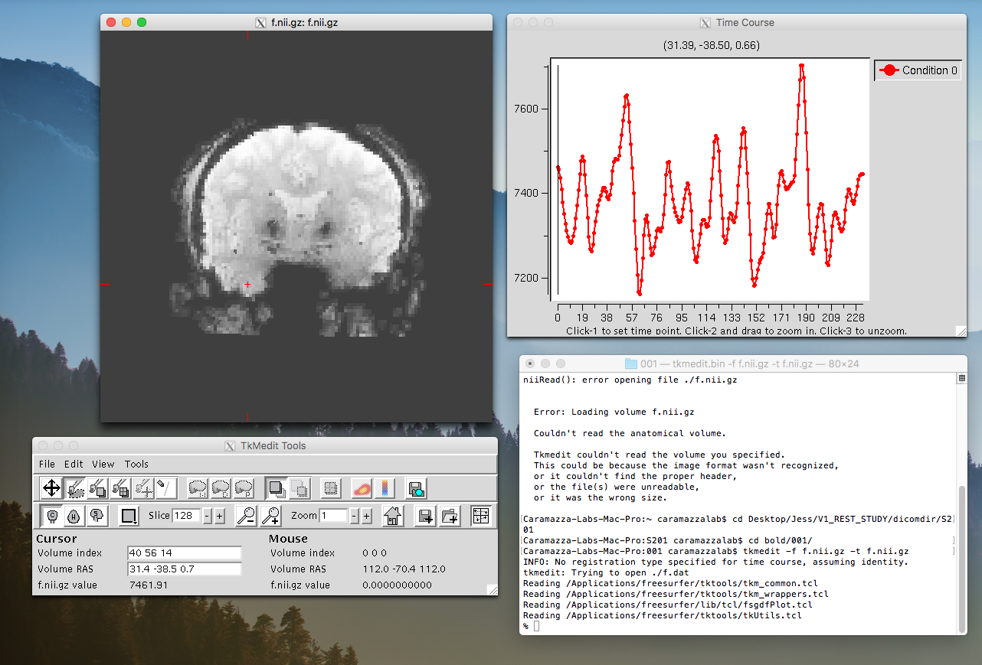
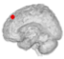
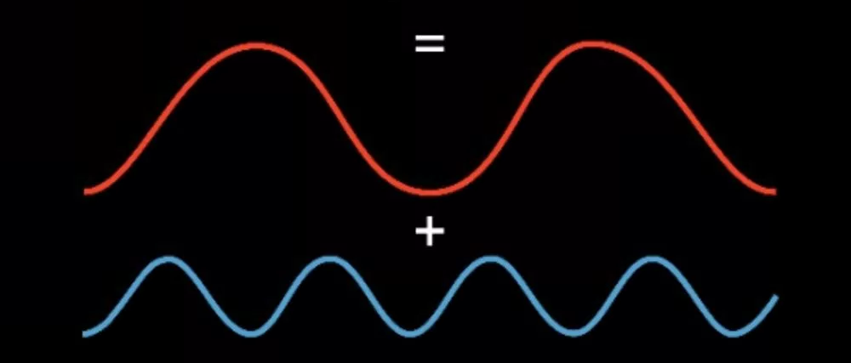
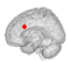

Decomposing V1 Signal
Extract Signal from V1
Decompose V1 signal into components
Evaluate correlation of components to other regions:
Auditory Network
Subcortical regions
Visual Network
Extract Signal from V1
Decompose V1 Signal
Relate V1 Signal to Signal in Other Regions

Slide 9

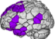


Decomposing V1 Signal
Project Goal: What are the resting state dynamics of the primary visual cortex (V1) in the congenitally blind?
→ “Variance of fluctuations of primary visual cortex is explained by signal in ....”

Slide 10
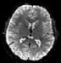
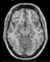
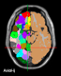
Theory: An Overview of Preprocessing
Notes:
In this talk, I want to tell you about the first steps in this long term project. I want to tell you about the first segment of this project, namely, a 9.2 week 9-to-5 segment of this project. My segment of this project and my exploration this summer falls under the umbrella term: preprocessing.
In this talk, I want to tell you about how far I progressed in this project. Namely, I went into the summer wanting to find out which regions and networks contributed to V1 activity. And to some degree, I did that. There’s more to do and I’ll show you what I found a couple minutes down the line. But along the way, I stumbled upon some real ingenuity in neuroscience. And today, I’d like to share with you some of this ingenuity. And how this project and this research is accelerated by our standing on the shoulders of ingenius giants! Something that these giants created … is called preprocessing.

Slide 11
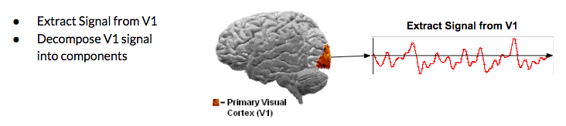

What is preprocessing?
Preprocessing:
Project Overview: Initial Step
Raw MRI Data
Commonly used technique for neuroimaging (MRI, fMRI, DTI, EEG)
Stripping, segmenting, co-registering, transforming, artefact correcting raw fMRI data for the sake of extracting biologically meaningful and less confounded measurements of brain activity
Preparing MRI data for biologically meaningful signal extraction
Notes:
Preprocessing is a pipeline of steps to prepare MRI data for biologically meaningful signal extraction. Preprocessing enables a researcher to go from raw imaging data to meaningful/ usable/ less confounded measurements of activity over time.

Slide 12
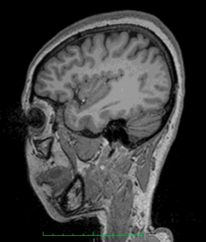
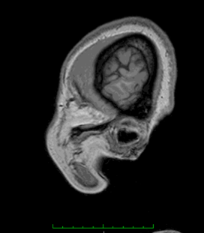
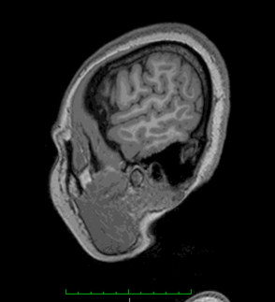
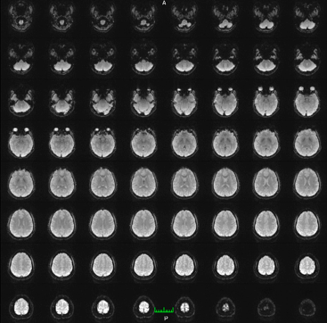
The Role of Preprocessing
?
Structural MRI
Functional MRI
MNI305 aseg+aparc Atlas
Extract Signal from V1
Notes:
<>
I want to send the message that even for this simple task of tracking V1 activity over time, there is genius and ingenuity that went into the design of preprocessing

Slide 13
What do we have? Structural & Functional Scans
Structural MRI
1 Scan = 192 DICOMs (Digital Imaging and Communication in Medicine)
Resting State Functional MRI (fMRI)
1 Scan = 240 DICOMs
1 DICOM every 2 seconds
Each DICOM contains 64 slices of the whole brain + information about the patient
8 minute scan
3 Structural MRI DICOM
Functional MRI DICOM
Notes:
Before preprocessing begins, we start with scans fresh off the press. Namely, for each subject, we acquired both structural and functional scans. Both scans consist of 2D images of the brain. Structural MRI indicates static anatomical information while functional MRI indicates dynamic physiological information. Structural MRI measures sagittal cross sections of the brain. A structural MRI scan is made up of these 192 slices of the brain. In contrast, functional MRI is indicative of dynamic activity over time. Thus, in our scans, ever two seconds, we took a snapshot of the entire brain - laid out one slice at a time across a DICOM. A full functional scan is a series of 240 snapshots of the entire brain, allowing us to track the entire brain over the course of all the snapshots. At two seconds per snapshot, the fMRI examines 8 minutes of activity

Slide 14
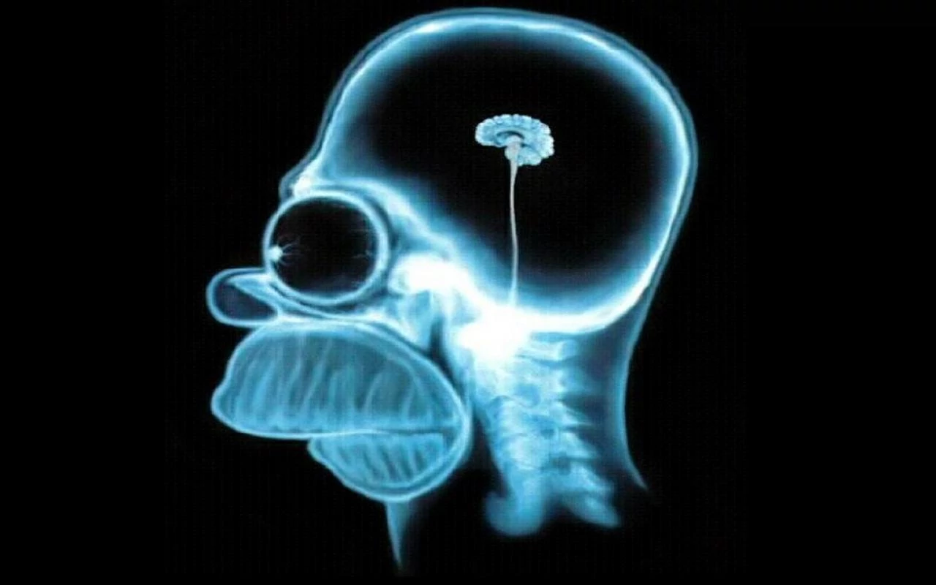
The Need for Preprocessing:
Different People, Different Brains
Assumption: Different people have different brains
Human Brain
Homer Simpson’s Brain
Notes:
<There are of differences between brain scans and meaningful brain activity --- so I’d like to share with you three hurdles in signal extraction and three ways that modern preprocessing resolves these hurdles>

Slide 15
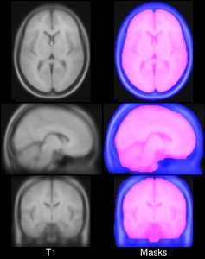
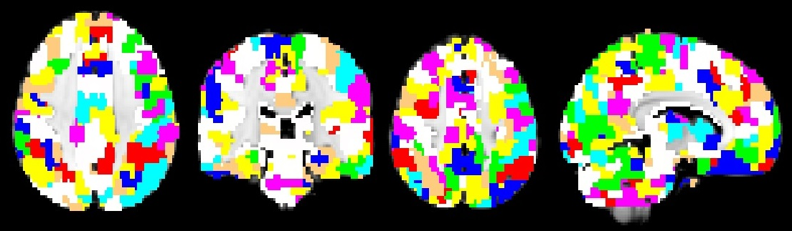
The Need for Preprocessing:
Different People, Different Brains
Assumption: Different people have different brains
Preprocessing Step: Average Atlas Transformation
Parcellation on MNI
MNI Brain

Slide 16
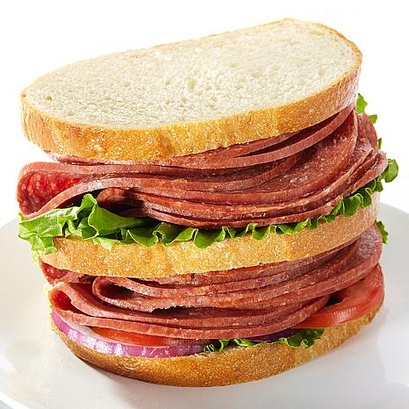
The Need for Preprocessing:
Scan Correction
Assumption: Within each functional MRI picture, slices are acquired at different times
2 sec
Acquisition Time @ 0 sec
2 sec
Acquisition Time @ 0 sec
Brain Slices in a DICOM
Sandwich Slices *Bologna

Slide 17
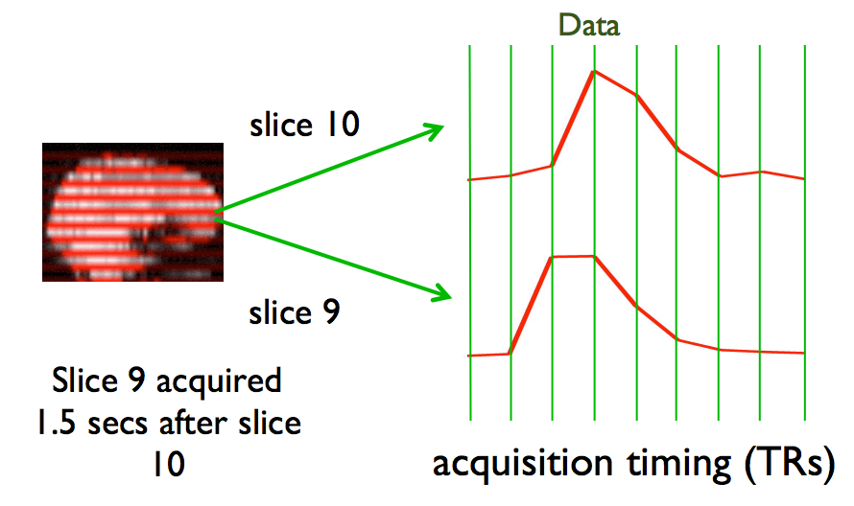

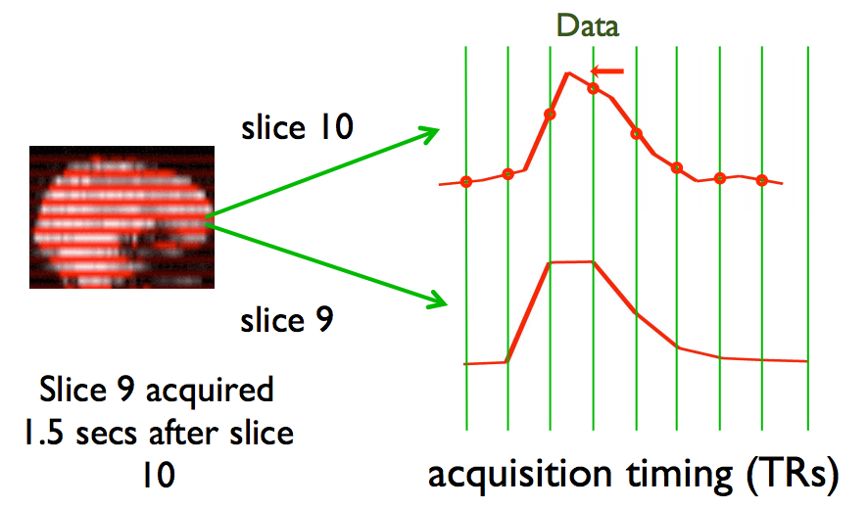

The Need for Preprocessing:
Scan Correction
Assumption: Within each functional MRI picture, slices are acquired at different times
Preprocessing Step: Slice Time Correction (STC)
Before STC
After STC
Slice
X
STC
Slice
X + 1

Slide 18
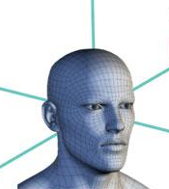
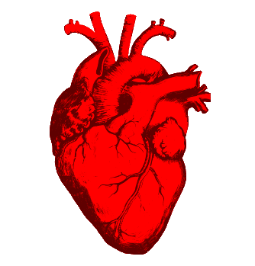
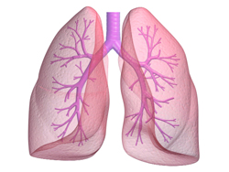
The Need for Preprocessing:
Beyond Brain Activity
Assumption: The scanner measures physiological information that isn’t brain activity
Head Motion
Heart Rate
Breathing
Notes:
The scanner measures information that isn’t brain actiivty

Slide 19
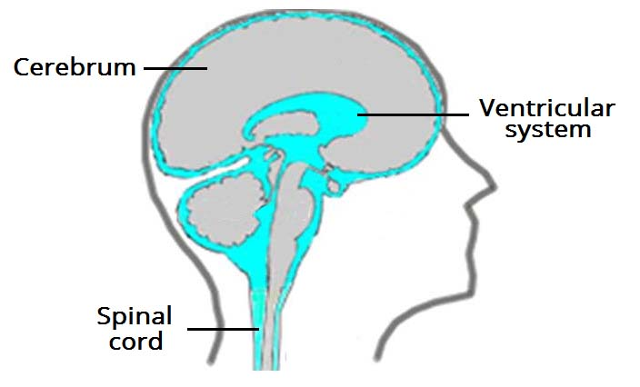
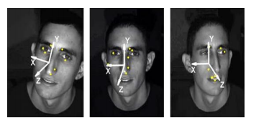
The Need for Preprocessing:
Beyond Brain Activity
Assumption: The scanner measures physiological information that isn’t brain activity
Preprocessing Step: Motion Correction and Nuisance Variable Regression
Track Motion in Scanner
Regress Ventricles and Cerebrospinal Fluid
Notes:
http://bmedesign.engr.wisc.edu/projects/file/?fid=2317
So we can get a sense of other physiology in the CSF and regress that from raw activity of brain regions

Slide 20

Implementation: Preprocessing in Full
Notes:
In this talk, I want to tell you about the first steps in this long term project. I want to tell you about the first segment of this project, namely, a 9.2 week 9-to-5 segment of this project. My segment of this project and my exploration this summer falls under the umbrella term: preprocessing.
In this talk, I want to tell you about how far I progressed in this project. Namely, I went into the summer wanting to find out which regions and networks contributed to V1 activity. And to some degree, I did that. There’s more to do and I’ll show you what I found a couple minutes down the line. But along the way, I stumbled upon some real ingenuity in neuroscience. And today, I’d like to share with you some of this ingenuity. And how this project and this research is accelerated by our standing on the shoulders of ingenius giants! Something that these giants created … is called preprocessing.

Slide 21
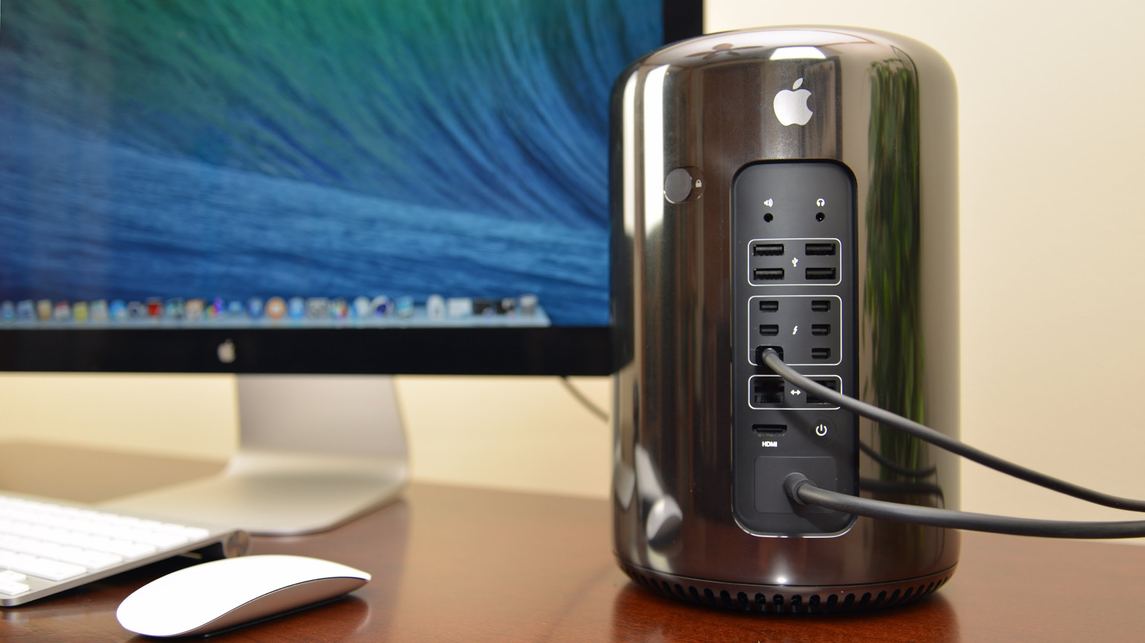
Equipment
Hardware
Mac SierraOS Pro 2013
Seagate Expansion Drive
Software
(Dropbox)
Linux, bash coding
Freesurfer Software
MATLAB
Mac Pro 2013
Notes:
I was physically moving brain scan files onto this computer, writing scripts, designing commands, looking through program documentation, and overall, trying to use the power computer science and strategic/ informed neuroimaging design to get brain scans from a raw image format to a usable form. I wanted to be able to look at a matrix of the entire brain and be able to pull up the brain activity of each brain region over time … but we’ll get there and meet some of the problems that all applied computer scientists face! … so even if you’re not a neuroscience person, alas, I have insights for you too.

Slide 22
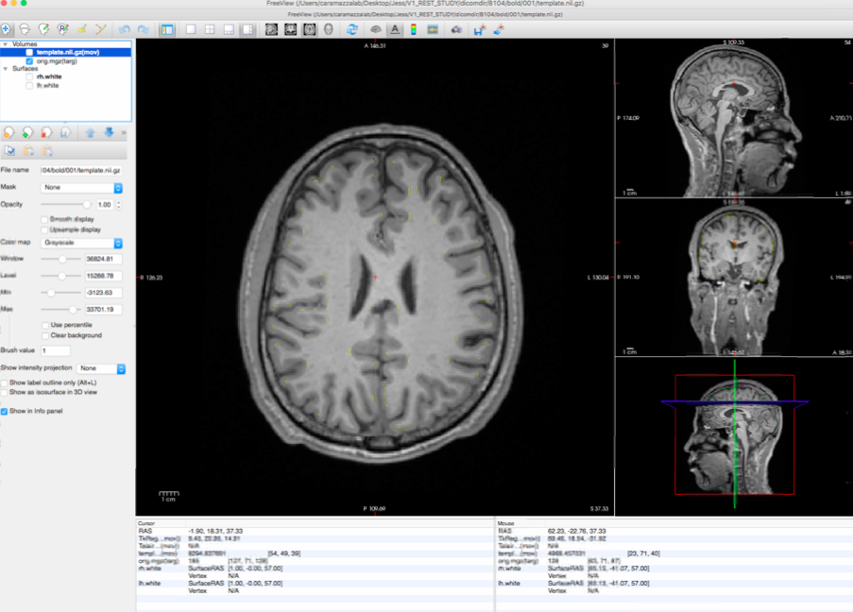
Preprocessing Pipeline: Anatomical and Functional 3D Construction
mri_convert
WXY101^GeJianbin-0006-0001-00001.dcm
f.nii.gz
192 Structural MRI DICOMs
1 Structural MRI
NIFTI
Notes:
I was physically moving brain scan files onto this computer, writing scripts, designing commands, looking through program documentation, and overall, trying to use the power computer science and strategic/ informed neuroimaging design to get brain scans from a raw image format to a usable form. I wanted to be able to look at a matrix of the entire brain and be able to pull up the brain activity of each brain region over time … but we’ll get there and meet some of the problems that all applied computer scientists face! … so even if you’re not a neuroscience person, alas, I have insights for you too.

Slide 23
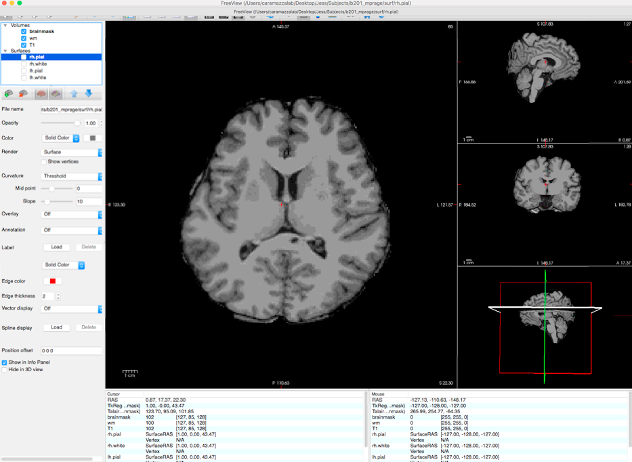
Preprocessing Pipeline: Anatomical Brain Stripping
recon-all
Desktop/RAW_DATA/S02_WAH_mprage/*.dcm
Structural NIFTI
Stripped Structural NIFTI
Notes:
I was physically moving brain scan files onto this computer, writing scripts, designing commands, looking through program documentation, and overall, trying to use the power computer science and strategic/ informed neuroimaging design to get brain scans from a raw image format to a usable form. I wanted to be able to look at a matrix of the entire brain and be able to pull up the brain activity of each brain region over time … but we’ll get there and meet some of the problems that all applied computer scientists face! … so even if you’re not a neuroscience person, alas, I have insights for you too.

Slide 24
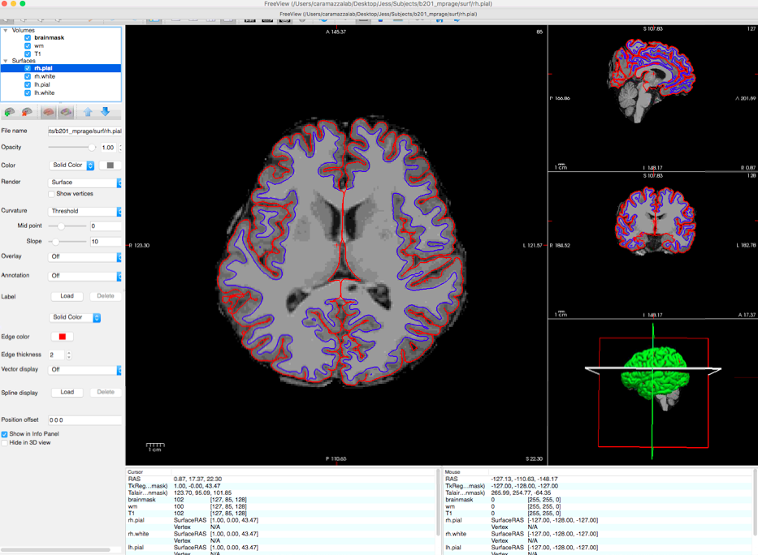
Preprocessing Pipeline: Anatomical Segmentation
recon-all
Desktop/RAW_DATA/S02_WAH_mprage/*.dcm
Stripped Structural NIFTI
Gray and White Matter Segmentation
Notes:
I was physically moving brain scan files onto this computer, writing scripts, designing commands, looking through program documentation, and overall, trying to use the power computer science and strategic/ informed neuroimaging design to get brain scans from a raw image format to a usable form. I wanted to be able to look at a matrix of the entire brain and be able to pull up the brain activity of each brain region over time … but we’ll get there and meet some of the problems that all applied computer scientists face! … so even if you’re not a neuroscience person, alas, I have insights for you too.

Slide 25
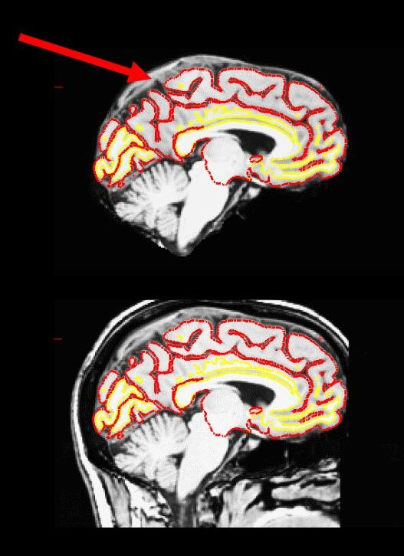
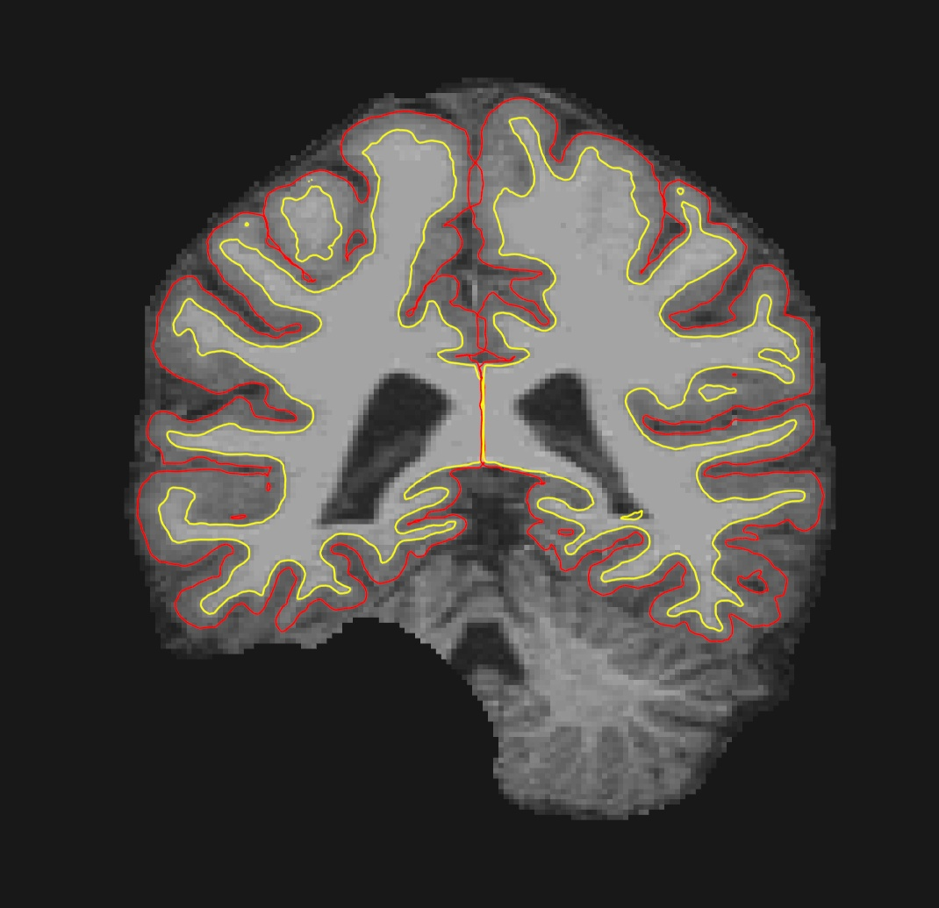
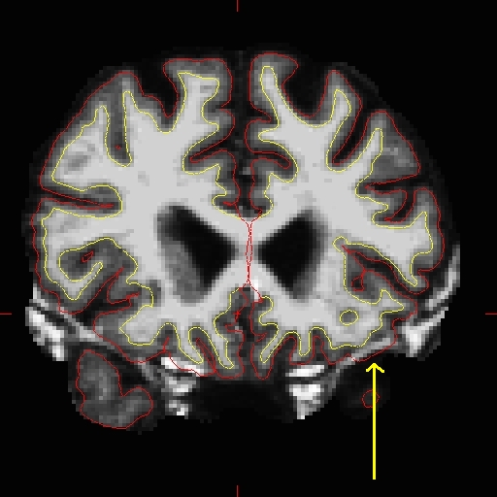
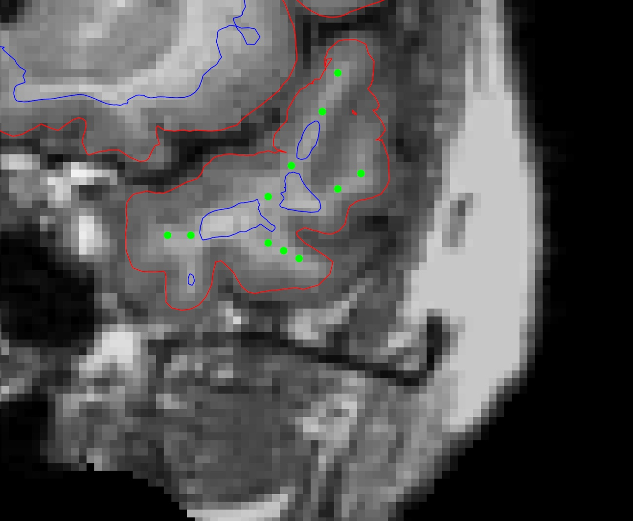
Preprocessing Pipeline: Anatomical Segmentation - Manual Correction*
Too Much
Skull Strip
Extending White Matter
Bad Skull Strip
Gray Matter Segmentation
Notes:
I was physically moving brain scan files onto this computer, writing scripts, designing commands, looking through program documentation, and overall, trying to use the power computer science and strategic/ informed neuroimaging design to get brain scans from a raw image format to a usable form. I wanted to be able to look at a matrix of the entire brain and be able to pull up the brain activity of each brain region over time … but we’ll get there and meet some of the problems that all applied computer scientists face! … so even if you’re not a neuroscience person, alas, I have insights for you too.

Slide 26
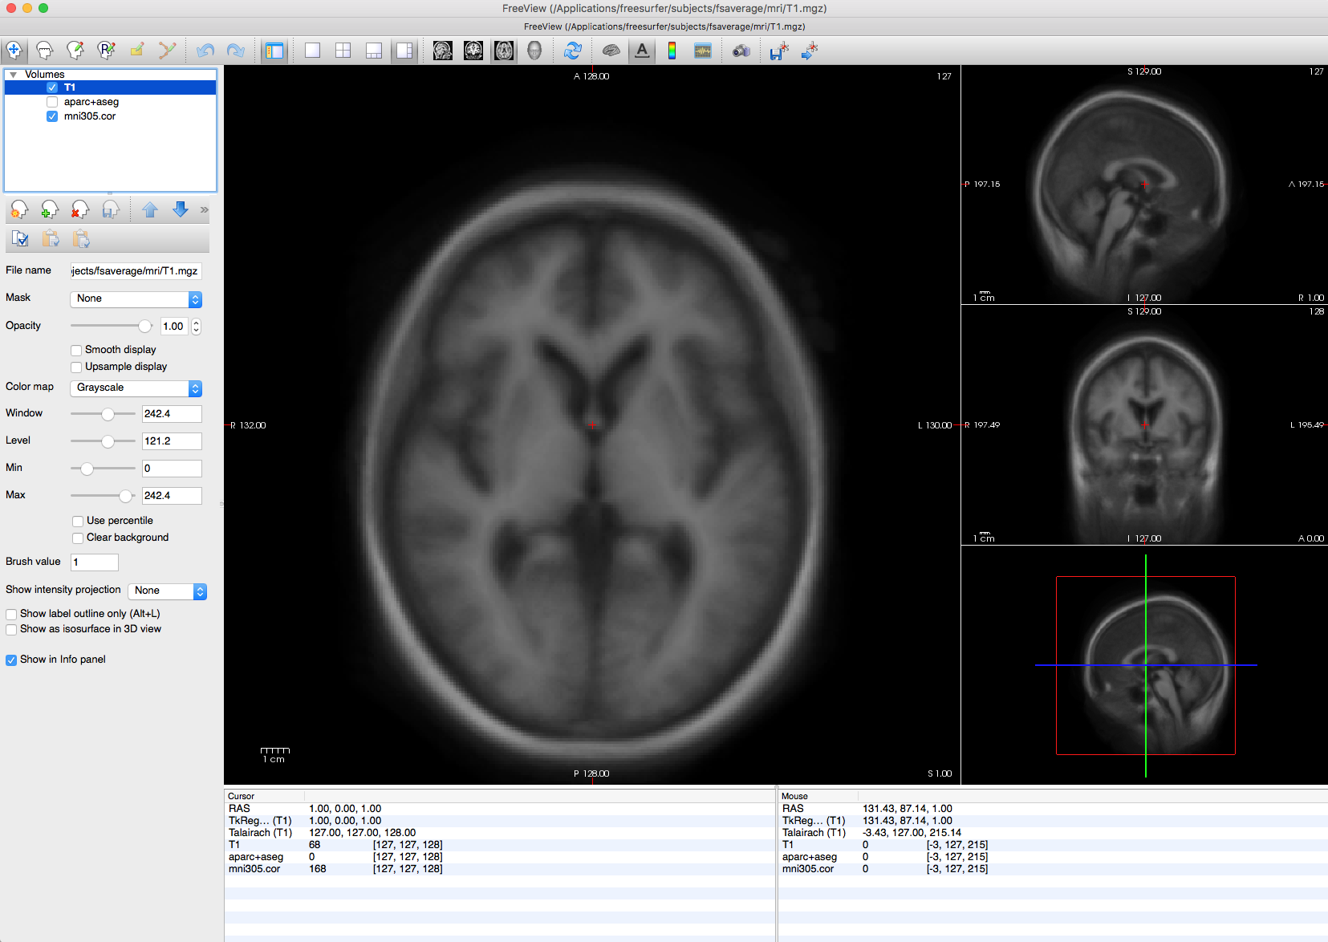
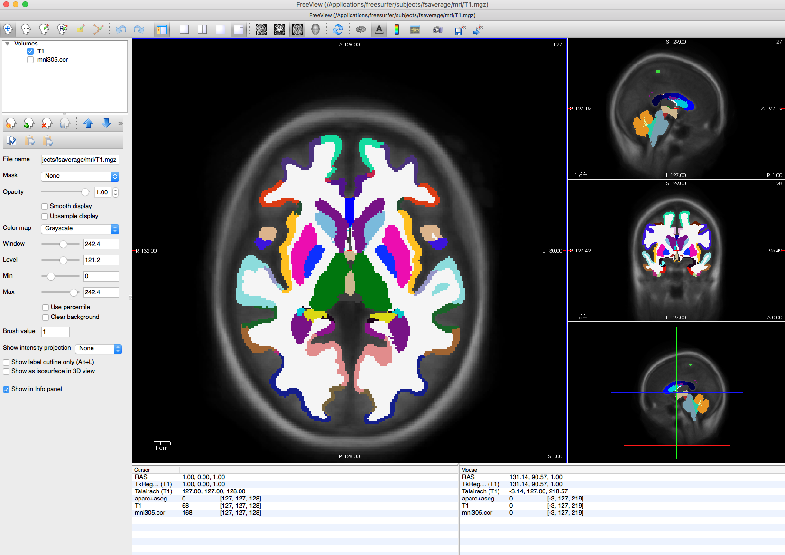
Preprocessing Pipeline: Functional to Anatomical Coregistration
MNI305
MNI305 with aparc+aseg

Slide 27
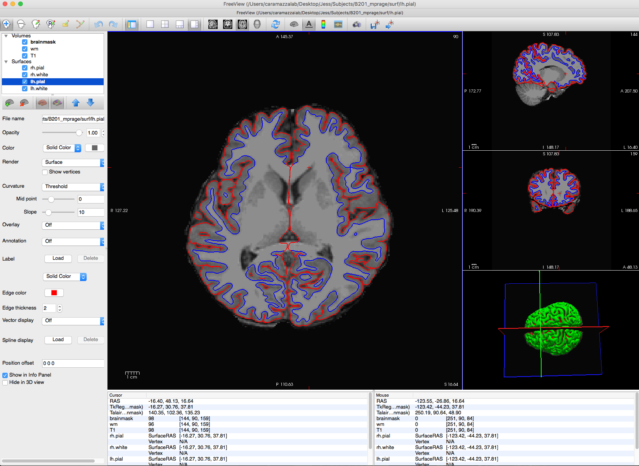
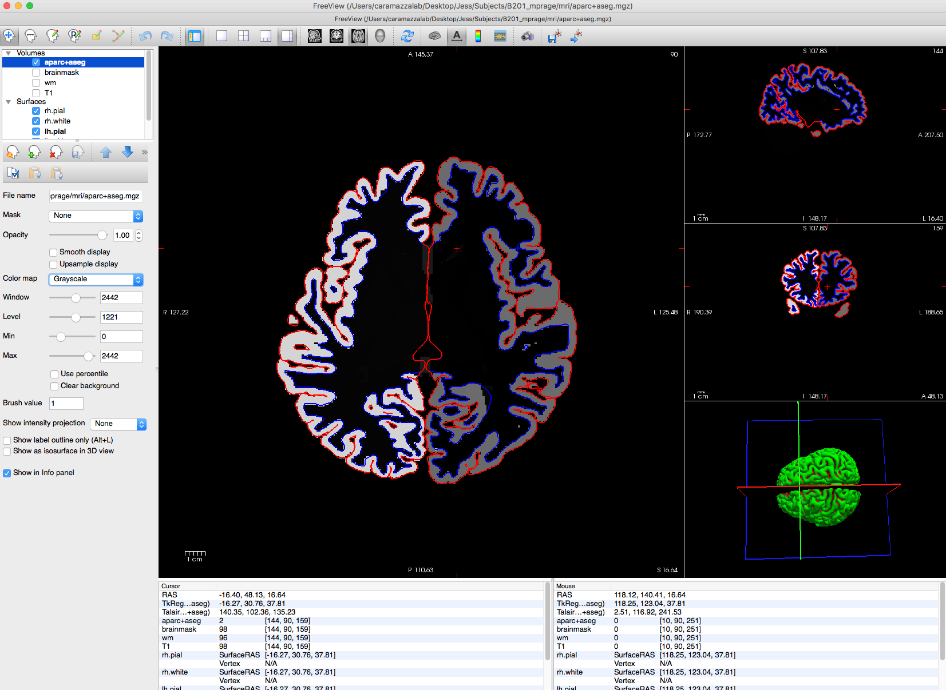
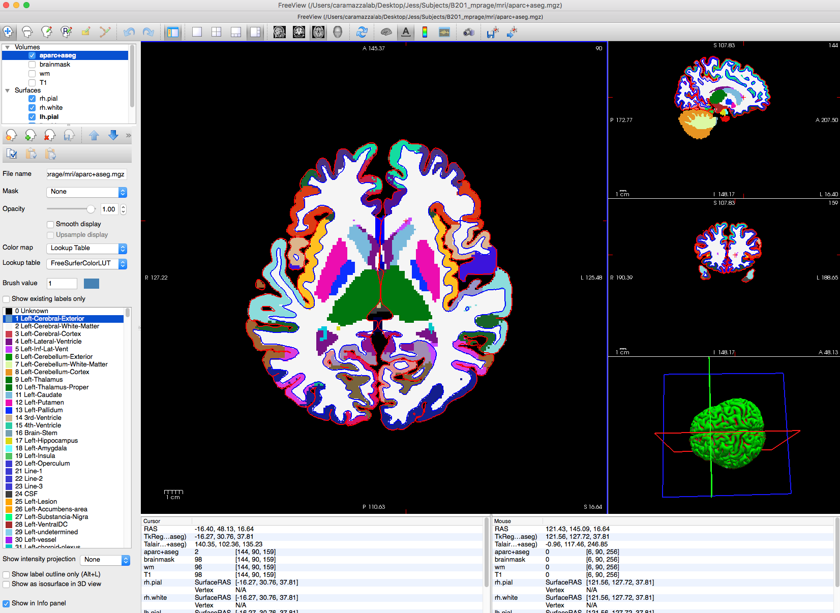
Preprocessing Pipeline: Functional to Anatomical Coregistration
Subject Brain
Subject Brain with MNI305
Subject Brain with MNI305 aparc+aseg

Slide 28
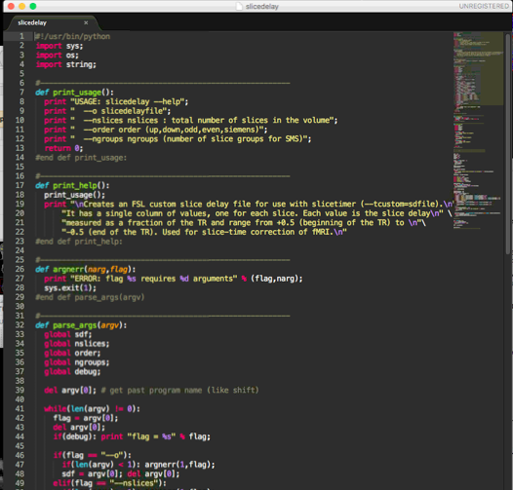

Slice Time Correction
Software for Slice Time Correction
Python to generate slice timings file
FSL (FMRIB Software Library) GUI for implementation
Python Slice
Timings Generator
FSL GUI

Slide 29

High and Low Pass Filtering
FSL (FMRIB Software Library): fslmaths f.nii.gz -bptf 25 2.5 f_filtered.nii.gz
Remove signals with frequency above 0.1 Hz (Low Pass Filtering)
Remove signals with frequency below 0.01 Hz (High Pass Filtering)
Low Pass Filtering in Quake Data

Slide 30


Motion Correction
Motion Standards
Clip time points with jumps in motion > 1mm
Remove subjects with > 2mm net motion
Motion (mm) vs. Time
Subject 2: 2 Motion Jumps > 1mm
Blind vs. Sighted:
not significantly different head motion between groups (mm)

Slide 31

Nuisance Variable Regression
Nuisance Variables
White matter, cerebrospinal fluid, ventricles … takes some of the effect of heart rate, breathing out because there shouldn’t be any resting state signal there
Regress Ventricles and Cerebrospinal Fluid
MATLAB regression

Slide 32

The Finale: Preprocessing for Time Course Extraction
After Preprocessing
Different People, Different Brains → Done
Scan Correction → Done
Brain Scanners Aren’t Measuring Only Brain Activity → Done
Biologically Meaningful Time Course Extraction

Slide 33
Theory + Implementation:
Beyond Preprocessing
Notes:
In this talk, I want to tell you about the first steps in this long term project. I want to tell you about the first segment of this project, namely, a 9.2 week 9-to-5 segment of this project. My segment of this project and my exploration this summer falls under the umbrella term: preprocessing.
In this talk, I want to tell you about how far I progressed in this project. Namely, I went into the summer wanting to find out which regions and networks contributed to V1 activity. And to some degree, I did that. There’s more to do and I’ll show you what I found a couple minutes down the line. But along the way, I stumbled upon some real ingenuity in neuroscience. And today, I’d like to share with you some of this ingenuity. And how this project and this research is accelerated by our standing on the shoulders of ingenius giants! Something that these giants created … is called preprocessing.

Slide 34
Where Am I Now?
Regions of Interest:
Visual Network
Auditory Network
Subcortical Regions
Language Regions
MATLAB Scripts:
Build_TC_mat.m : script to extract time courses from all subjects
TimeCourseStats1_semi_automated.m : function to compute correlations between time courses
Brodmann Areas

Slide 35



Sneak Peek of Functional Connectivity:
Visual Network
Blind V1, relative to sighted V1 exhibited around the same correlation to visual regions (V1, V2)
Blind V1, relative to sighted V1 exhibited increased correlation to language regions (BA44, BA45)
Blind V1, relative to sighted V1 exhibited decreased correlation to sensory motor regions (BA3a, BA3b)
Visual Networks
Language Regions
(Broca’s Area)
Sensory Network

Slide 36

Where Am I Going?
Decompositions of Interest:
Principal Component Analysis
Independent Component Analysis
Singular Value Decomposition
Metrics of Interest:
How is variance in V1 activity explained by other networks?
How much variation of V1 activity exists between the blind? Between the sighted?
Is neuroplastic connectivity of V1 during rest consistent with V1 activity during tasks?
Principal Component Analysis

Slide 37
Conclusions
Brain Scans Aren’t Brains, and Preprocessing Enables a Bridge
People move and breath in the scanner, scanners acquire slices at different times, brains are different shapes and sizes
Preprocessing enables biologically meaningful signal extraction
Vision Is Dynamic:
V1’s Nature vs. Nurture: Stable connectivity (Vision) vs. Altered Connectivity (Language, Sensory Motor)
Research Leaves us In Awe:
Preprocessing is used in every neuroimaging study published today

